Slide 1



EVENT MANGAGEMENT SYSTEM
PROJECT GUIDE
PROJECT MEMBER
Varsha S
Yaswanth Raj E
Sidharth S

Slide 2
PROBLEM STATEMENT
To design and develop an event management system that allows event organizers to submit events for approval, facilitates the approval process by a central authority, and subsequently displays approved events to students. The system should also enable event organizers to view participant details.

Slide 3
OBJECTIVE
To design and develop an event management system that allows event organizers to submit events for approval, facilitates the approval process by a central authority, and subsequently displays approved events to students. The system should also enable event organizers to view participant details.

Slide 4
EXISTING SYSTEM
The existing event management system provides a basic framework for event organizers to submit events and for students to view them. However, it lacks a central approval process and participant management functionality, leading to potential inefficiencies and quality issues. Enhancing the system to include these features will improve overall event coordination and user satisfaction.

Slide 5
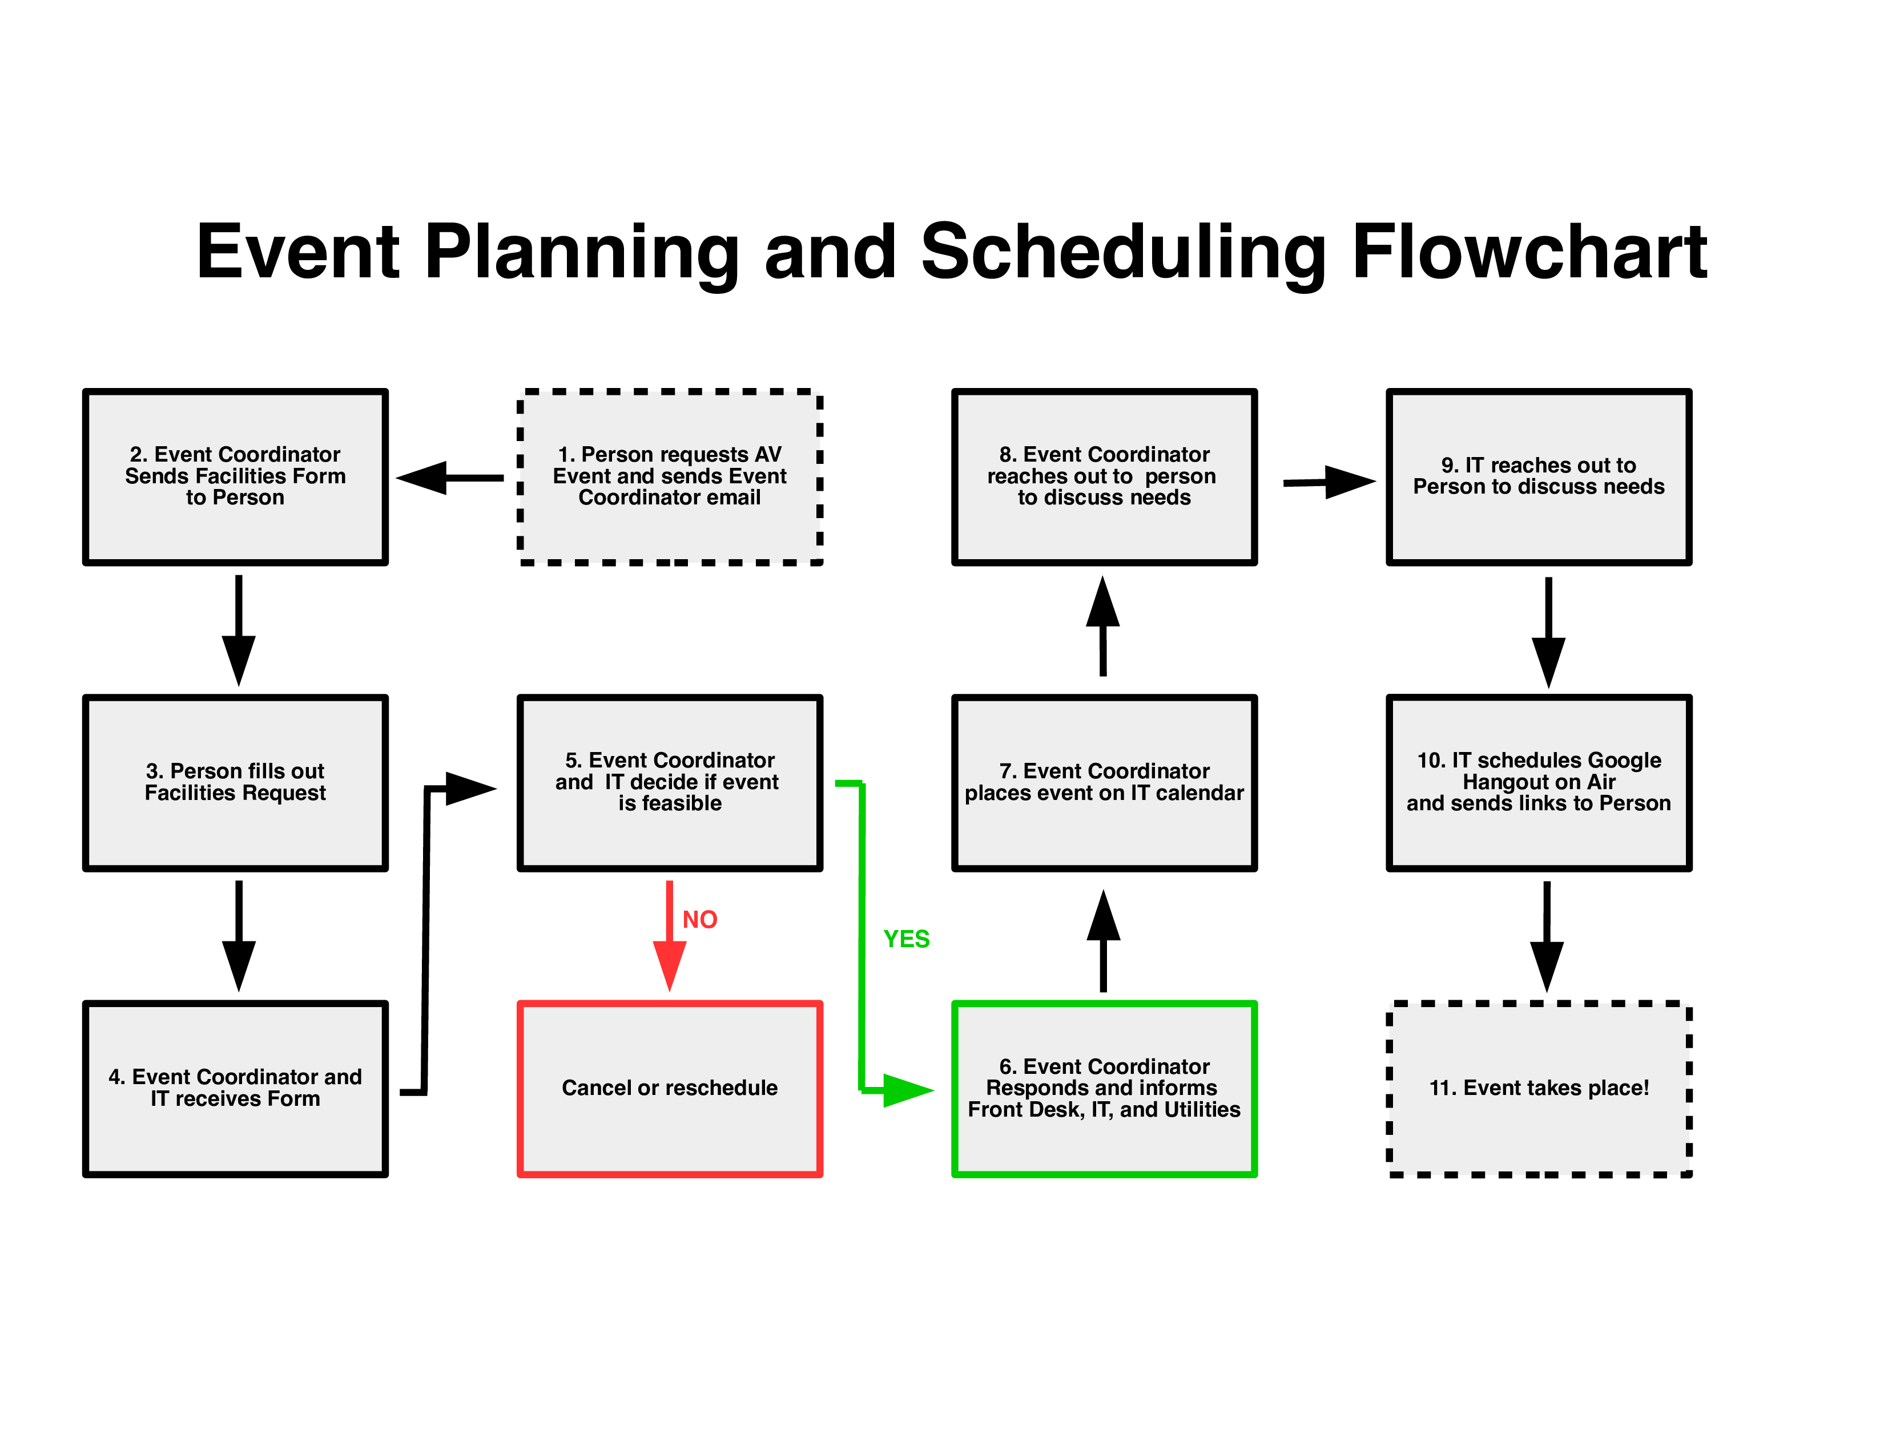
PROPOSED WORK – BLOCK DIAGRAM

Slide 6
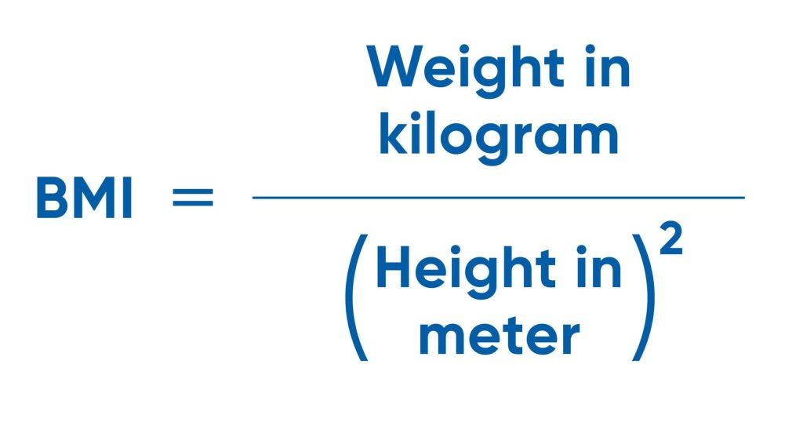
SOLUTION
A more organized event management process with a central approval system.
Enhanced control over event quality and relevance.
Improved participant management capabilities for event organizers.
Clear roles and permissions ensuring secure and appropriate access.
An updated user interface that integrates new functionalities while remaining user-friendly.
Effective communication and notifications keeping all stakeholders informed.

Slide 7
CONCLUSION
By incorporating a central approval process and participant management functionality, the enhanced event management system will significantly improve the efficiency and transparency of event coordination. These enhancements will ensure that only approved events are displayed to students and that event organizers can effectively manage participant details, contributing to a more organized and engaging campus event experience.

Slide 8
THANK YOU

